Slide 1
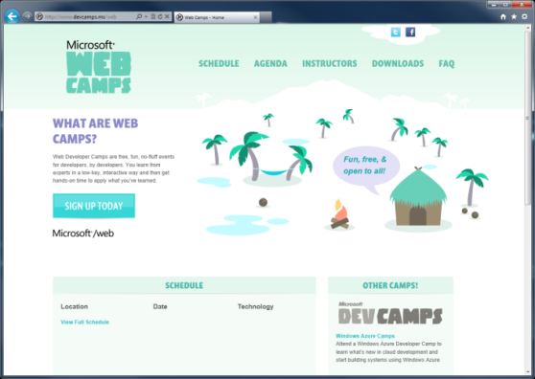

WebCamps Online
Twitter: Follow @webcamps Hashtag #webcamps
SPEAKER NAME/HANDLE HERE
Website: http://www.devcamps.ms/web
What are web camps?
Web Developer Camps are free, fun, no-fluff events for developers, by developers. You learn from experts in a low-key, interactive way and then get hands-on time to apply what you’ve learned.

Slide 2
Creating Rich HTML 5 Experiences
Name
Title
Microsoft Corporation

Slide 3
Agenda
HTML 5 in IE 9 & 10
HTML5 Deep Dive
jQuery Fundamentals

Slide 4

What is HTML5?
It isn’t a marketing message
It is the future of the web
A language with support on a variety of devices

Slide 5
HTML 5 in IE 9 & 10

Slide 6
HTML5 in IE9
HTML5
CSS3
SVG
Others
New Markup Elements
Canvas
Audio
Video
Local Storage
Cross-Window Messaging
Text Selection APIs
Parsing SVG in HTML
2D Transforms
Border Radius
Box-Shadow
Fonts (WOFF)
Media Queries
Multiple Backgrounds
Namespaces
Opacity
rgba(), hsl(), hsla()
Selectors (IE8)
Shapes
Clipping, Masking, and Compositing
Transforms
Extensibility
Gradients
Interactivity
Linking and Views
Painting and Colors
Paths
Text
ECMA Script 5 (all but Strict Mode)
Native JSON support
Performance API
Geo-Location
Data-uri (IE8)
DOM L2, L3
Selectors API L2
AJAX Navigation
DOMParser and XMLSerializer
ICC v2 and Color Profile
ARIA
Hardware Acceleration

Slide 7
HTML5 in IE10
HTML5
CSS3
Others
Application Cache
Drag&Drop
File API
Forms Validation
History
IndexedDB
Sandbox
Web Sockets
Web Workers
3D Transforms
Animations
Flexible Box
Floats
Gradient
Grid
Multi-Column
Region
SVG Filter Effects
Text Shadow
Transitions
Advanced Hit Testing APIs
Async
Media Queries Listeners
Web Performance APIs

Slide 8
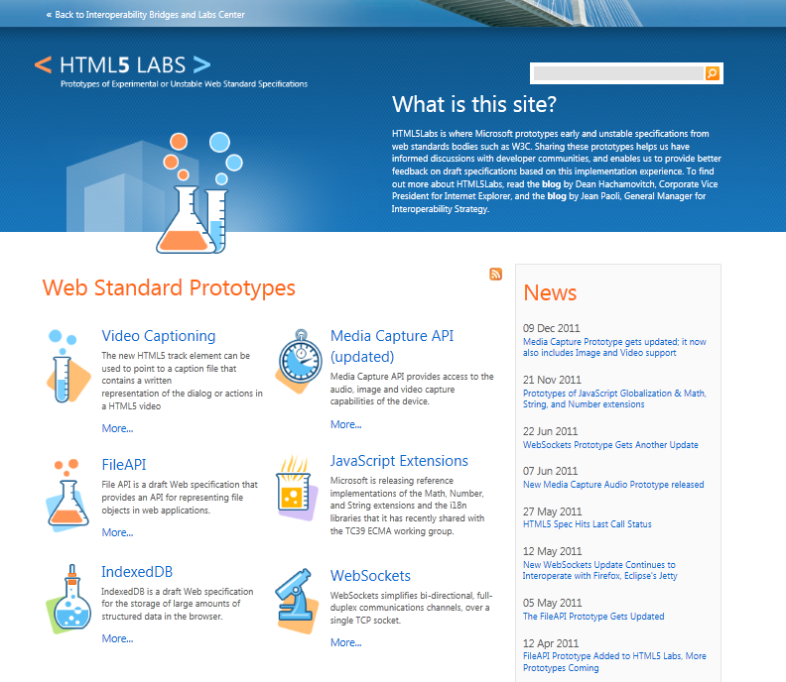
html5labs.com
HTML5 IndexedDB, Web Sockets, File API, and Media Capture API

Slide 9
HTML5 Deep Dive

Slide 10
Map of HTML5
ECMAScript 262
W3C
ECMA
HTML
CSS
Web Apps
SVG
Geolocation
ECMA Script 262
Geolocation API
Basic Shapes
DOM L2 Style
Web SQL Database
CSS Text
Filters
Document Structure
DOM L2 Events
Web DOM Core
CSS Cascading And Inheritance
CSS Writing Modes
HTML5 Diff From HTML4
Fonts
DOM L3 Abstract Schemas
DOM L2 Views
Uniform Messaging Policy
CSS Speech
CSS Values And Units
HTML5 Markup
Smil
DOM L3 Views And Formatting
DOM L2 Core
Server-sent Events
Element Traversal
CSS Color
CSS Media Queries
CSS Print Profile
Html+rdfa
Gradients And Patterns
DOM L3 Xpath
Dom L1
Selectors API L2
Cors
CSS Template Layout
CSS Paged Media
Microdata
Styling
DOM L3 Validation
Xmlhttprequest L2
Selectors API
CSS Animations
CSS Multi-column Layout
CSS Namespaces
Canvas 2D Context
Scripting
DOM L3 Load And Save
Xmlhttprequest
Progress Events
CSS Transitions
CSS Basic Box Model
CSS Snapshot 2007
Html5
Painting, Filling, Color
DOM L3 Events
Web Workers
CSS 3D Transformations
CSS Fonts
Text Alternatives
Transforms
DOM L3 Core
Web Storage
Programmable HTTP Caching And Serving
CSS 2D Transformations
CSS Backgrounds And Borders
Polyglot Markup
Text
Dom L2 Html
Web Sockets API
Index DB
CSS Image Values
Paths
DOM L2 Traversal And Range
Web IDL
File API
CSS Flexible Box Layout
CSS Generated Content For Paged Media
CSS Line Grid
CSS Grid Positioning
CSS Ruby
CSS Scoping
CSS Basic User Interface

Slide 11
New HTML5 Markup Elements
<header>
used to identify the page or application's introduction or navigational aids
<hgroup>
used to group heading elements
<nav>
represents a section of a document that links to other documents or to parts within the document itself
<aside>
represents content that is tangentially related to the content that forms the main textual flow of a document
<footer>
represents the footer for the nearest ancestor sectioning content or sectioning root element
<article>
represents a section of content that forms an independent part of a document or site
<section>
used to designate generic sections of a document
<figure>
used to enclose a figure like an illustration, diagram, or photo
<figcaption>
used to identify a figure's caption
<video>
represents a video player displayed to allow user control over video playback and a viewport to view a video
<audio>
represents an audio player displayed to allow user control over audio playback

Slide 12
Canvas
A block element that allows developers to draw 2d graphics using JavaScript
Methods for drawing include: paths, boxes, circles, text and rasterized images
<canvas id="myCanvas" width="200" height="200">
Your browser doesn’t support Canvas, sorry.
</canvas>
<script type="text/javascript">
var example = document.getElementById("myCanvas");
var context = example.getContext("2d");
context.fillStyle = "rgb(255,0,0)";
context.fillRect(30, 30, 50, 50);
</script>

Slide 13
HTML 5 <video>
Support for the HTML5 <video> element
Industry-standard MPEG-4/H.264 video
Video can be composited with anything else on the page
HTML content, images, SVG graphics
Hardware accelerated, GPU-based decoding

Slide 14
HTML 5 <video> Attributes
src – specifies the location to pull the source file
autoplay – if present starts playing as soon as it’s ready
controls – if present displays controls
preload – if present loads source at page load
loop – if present loops back to the beginning of the video
height & width – specifies the height & width of the player
<video src="video.mp4" id="videoTag" width="640px" height="360px">
<!-- Only shown when browser doesn’t support video -->
<!-- You Could Embed Flash or Silverlight Video Here -->
</video>

Slide 15
Multiple HTML 5 <video> Sources?
source – child element used to specify the location to pull the source file(s)
<video poster="video.jpg">
<source src="video.mp4"/>
<source src="video.ogv"/>
<p>This is fallback content</p>
</video>

Slide 16
HTML 5 <audio>
Industry-standard MP3 and AAC audio
Fully scriptable via the DOM
Attributes
src – specifies the location to pull the source file
autoplay – if present starts playing as soon as it’s ready
controls – if present displays controls
preload – if present loads source at page load
<audio src="audio.mp3" id="audioTag" autoplay controls>
<!-- Only shown when browser doesn’t support audio -->
<!-- You could embed Flash or Silverlight audio here -->
</audio>

Slide 17
HTML5
demo
New markup features

Slide 18
Scalable Vector Graphics (SVG)
Create and draw 2D vector graphics using XML
Vector images are composed of shapes instead of pixels
Based on the SVG 1.1 2nd Edition Full specification
Full DOM access to SVG elements
Document structure, scripting, styling, paths, shapes, colors, transforms, gradients, patterns, masking, clipping, markers, linking and views

Slide 19
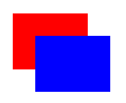
SVG Code Example
A block element that allows developers to draw 2d graphics using JavaScript
Methods for drawing include: paths, boxes, circles, text and rasterized images
<svg width="400" height="200" xmlns="http://www.w3.org/2000/svg">
<rect fill="red" x="20" y="20" width="100" height="75" />
<rect fill="blue" x="50" y="50" width="100" height="75" />
</svg>

Slide 20
SVG
Basic Shapes
Gradients, Patterns
Paths
Styling
Text
Scripting
Transforms
Painting, Filling, Color

Slide 21
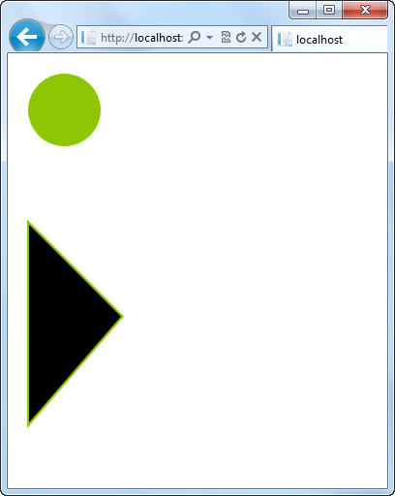
Creating SVG Shapes
Declarative creation of shapes
Numerous shapes available: circle, rect, ellipse, line, polyline, polygon, path
<svg height="200" xmlns="http://www.w3.org/2000/svg">
<circle id="blueCircle"
cx="70"
cy="70" r="50"
fill="#8dc703" />
</svg>
<svg height="200" xmlns="http://www.w3.org/2000/svg">
<path d="M 20 20 L 150 150 L 20 300 z"
fill="#000"
stroke="#8dc703"
stroke-width="3" />
</svg>

Slide 22
SVG
demo
Vector graphics via markup

Slide 23
CSS3 Fonts & @font-face
Web Open Font Format allows you to package and deliver fonts as needed, per site
Designed for web use with the @font-face declaration
<style type="text/css">
@font-face {
font-family:MyFontName;
src: url('FontFile.woff');
}
</style>
<div style="font: 24pt MyFontName, sans-serif;">
This will render using MyFontName in FontFile.woff
</div>

Slide 24
CSS3 Media Queries
Selectively style page based on properties of the media
<style type="text/css">
@media all and (min-width: 640px)
{
#media-queries-1 { background-color: #0f0; }
}
@media screen and (max-width: 2000px)
{
#media-queries-2 { background-color: #0f0; }
}
</style>

Slide 25
CSS3 Colors
Alpha color with rgba() and hsla() color definitions
Transparency control with the opacity property
Can be used with any property that takes the color property
div.top {
background-color: rgba(0, 0, 0, 0.5);
color: #eeoocc;
}
div.bottom {
background-color: hlsa(0, 0%, 0%, 0.5);
color: #99cc44;
}

Slide 26
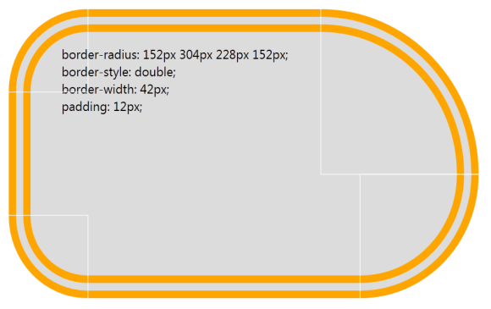
CSS3 Borders
Round corners with the border-radius property
Multiple background images per element
Box-shadow property on block elements
div {
border-radius: 152px 304px 228px 152px;
border-style: double;
border-width: 42px;
padding: 12px;
}

Slide 27
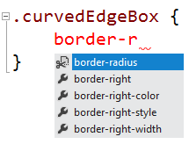
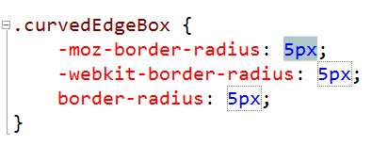
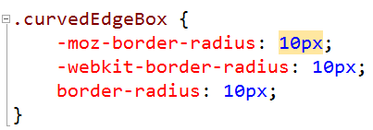
CSS3 Vendor Prefix Support
Vendor prefixing supported in Visual Studio 11
Autocomplete fills in based on tweak syntax
User clicks tab
User Edits and value is pre-populated

Slide 28
CSS3 Demo
demo

Slide 29
jQuery Fundamentals

Slide 30
Who Uses jQuery?
25,343,057 Web Sites
1,778,334 of those sites rank in the top sites on the web
Source: http://trends.builtwith.com/javascript/jQuery

Slide 31
jQuery – why so popular?
Easy to learn
Loads of Plugins
Powerful DOM Selection
Lightweight
Community Support

Slide 32
jQuery Community
jquery.com
api.jquery.com
forum.jquery.com
meetups.jquery.com
plugins.jquery.com
jqueryui.com
Downloading
Documentation
Community
Local Community
Extending
UI Widgets and Effects

Slide 33
jQuery Fundamentals
Find something using a selector
Do something to what’s been selected
<script>
$(‘div’).hide();
</script>
<div>This will be hidden</div>
<div>So will this</div>
<div>Even this</div>

Slide 34
Functional Syntax
Introduces functional handling of browser or DOM events
<script>
$(function() {
$('.submitButton').click(function(){
alert('post form');
});
});
</script>
<input class=“submitButton” type=“button” value=“Submit”/>

Slide 35
DOM Manipulation
jQuery can create new elements or alter existing elements
<script>
$(document).ready(function() {
$('.submitButton').click( function(){
$('.submitButton').css('color', '#ff0000');
$('#container').append('<span>Clicked!</span>');
});
});
</script>
<div id="container">
<input class="submitButton" type="button" value="Submit"/>
</div>

Slide 36
Chaining with jQuery
DOM events can be attached to elements as they are added to the DOM
<script>
$(document).ready(function() {
$('.submitButton').click( function(){
$('.submitButton').css('color', '#ff0000');
$('#container')
.append($('<span>Clicked!</span>')
.click(function(){
alert('foo');
})
);
});
});
</script>

Slide 37
jQuery Fundamentals
demo

Slide 38
jQuery Fundamentals
Find Something
Do Something
$(“#something”).hide();
<div id=“something”></div>
Notes:
Estimated Time: 2 minutes
Talking Points:
jQuery you typically find something, then do something with what you found.
Syntax for finding stuff is the same as the syntax used in CSS to apply styles.
Once something is selected, there are many different jQuery methods to do things.

Slide 39
How to start with jQuery
jQuery selections can contain many elements
<div class=”myClass foo bar”></div> <div class=”baz myClass”></div> <div class=”bar”></div>
//...
$(‘.myClass’).hide();
//...
<div class=”myClass foo bar”></div> <div class=”baz myClass”></div> <div class=”bar”></div>
Notes:
Estimated Time: 2 minutes
Talking Points:
When selecting with jQuery you can end up with more than one element.
Any action taken will typically affect all the elements you have selected.

Slide 40
DOM Manipulation
jQuery can create new elements
Still selecting something (brand new), then doing something.
$(‘<ul><li>Hello</li></ul>’)
.appendTo(‘body’);
Notes:
Estimated Time: 2 minutes
Talking Points:
You can create HTML elements on the fly with jQuery very easily, and then take action (such as adding that new element to the page).

Slide 41
Removing Elements
// Before
<div>
<p>Red</p>
<p>Green</p>
</div>
// Removing Elements $(‘p’).remove();
// After
<div>
</div>
Notes:
Estimated Time: 1 minutes
Talking Points:
Just as you can elements to the DOM, you can also remove elements from the DOM.

Slide 42
jQuery Events
// Binding an event
function() myClickHandler {
// event handling code
$(this).css(‘color’, ‘red’);
};
$('a.tab').click(myClickHandler);
Notes:
Estimated Time: 2 minutes
Talking Points:
With jQuery binding to events is very easy. We can specify a click handler for example by using the click method.
The above example will bind the “myClickHandler” function to all anchors with a class of tab

Slide 43
jQuery Events
// Binding an event
$('a.tab').click( function() {
// event handling code
$(this).css(‘color’, ‘red’);
});
Notes:
Estimated Time: 3 minutes
Talking Points:
In JavaScript functions can be passed as parameter.
Functions in JavaScript do not have to have a name.
This is the same exact functionality as the last slide, except we simply declare the function inline as the first parameter of the click method.
This is important because in the previous example we polluted the global scope with a new function name, which was and can be dangerous as someone could overwrite your function with their own accidentally.

Slide 44
jQuery & Chaining
$(‘tr:odd’)
.addClass(‘odd’)
.click( function () {
alert(‘you clicked a tr!’);
});
Notes:
Estimated Time: 3 minutes
Talking Points:
With jQuery many methods allow chaining.
Chaining is where you can continue to “chain” on methods one after another.
As an example, the addClass method will add the class ‘odd’ in the code above, and then return the jQuery collection it was given. This is why we can immediately chain on the “click” event
Click then operates on the odd rows by adding a click handler to each of them.

Slide 45
jQuery Stack Architecture
$(‘body’) // [body]
.find(‘p’) // [p, p, p] > [body]
.find(‘a’) // [a, a] > [p, p, p] > [body]
.addClass(‘foo’)
.end() // [p, p, p] > [body]
.end() // [body]
Notes:
Estimated Time: 3 minutes
Talking Points:
Some jQuery methods chain, but they return a whole new collection of elements. ‘Find’ and ‘Filter’ are two examples.
jQuery holds on to the previous collections, essentially creating a stack (last in first out) set to store them.
Methods like Find and Filter create a new collection which is added to stack. older collections are pushed further ‘downward’ on the stack
You can get a previous collection that was placed on the stack by using the end() method.

Slide 46
jQuery & Chaining
$(‘tr’)
.filter(‘:odd’)
.addClass(‘myOddClass’)
.end()
.filter(‘:even’)
.addClass(‘myEvenClass’);
Notes:
Estimated Time: 2 minutes
Talking Points:
This is a popular use that shows both chaining and the stack architecture.
We first select all rows
We then filter that selection down to only the odd rows (the odd rows are placed on the top of the stack, and the ‘all rows’ collection is now ‘pushed downward’)
We add a class to the odd rows
We call end, which throws away our odd rows collection and grabs the next element in the stack (‘all rows’ collection)
We then filter to find even rows (again the stack behavior would occur)
We add a class to the even rows

Slide 47
Chain Breakers
//Getters vs. Setters
$(...).html(‘Hello world’).addClass(‘hello’)
// Non breaking
var html = $(...).html().addClass(‘hello’)
// Breaking, html() returns a string.
// addClass method is undefined on a string
Notes:
Estimated Time: 4 minutes
Talking Points:
Not all methods can be chained.
Some methods can operate as “getters”, which return an string.
Example: calling .html() with no parameters gets the HTML inside an element as a string. You can’t chain after that as you now have a string.
calling .html() with a string as the first parameter acts as a setter - which once the HTML is set, then the jQuery collection IS returned. You can then continue to chain.
Visual Studio 2010 Intellisense can help when figuring out whether or not you can chain!
You can also find out whether or not a methods chains by looking at api,jquery.com. If the method returns “jQuery” on the api site, then you know it can be chained.

Slide 48
jQuery Fundamentals
Demonstration
Notes:
Use the Demo Script for jQuery Fundamentals

Slide 49
jQuery Ajax
Core Method
$.ajax();
Shortcut Methods
$.get(), $.post()
$.getJSON, $(...).load()
Notes:
Estimated Time: 3 minutes
Talking Points:
jQuery.ajax() is the core method - the shortcut methods use it ‘under the hood’. Thus it can do everything.
$.get() and $.post() set a single parameter - the type of HTTP Action that will occur (POST or GET)
$.getJSON will use the get HTTP action and will inform the server to send JSON back
$(...).load() will get HTML from the server and load it into whatever you have selected. Super simple! (more on next slide)
Note that there is no selection going on (except .load()). With certain jQuery methods there isn’t a a logical reason to make a selection first - most Ajax methods fall into that category. So they fall into the same

Slide 50
jQuery Ajax - $.load()
You can return any portion of any ASP.NET page and add it to the page with jQuery.load.
$(‘#myContainer’).load(‘home/myHtmlSnippet’);
Notes:
Estimated Time: 3 minutes
Talking Points:
$(...).load() will get HTML from the server and load it into whatever you have selected.
You could have the ASP.NET MVC server render a partial view, and return that with load!
Note that the server should return a partial page only. If it returns a whole page, then we are going to have some invalid HTML!

Slide 51
jQuery Ajax - $.getJSON()
// Response
{“names”: [“Joe”, “Jim”, “Bob”]}
$.getJSON(‘my/page/route’,
function(json) {
$(‘body’)
.append( json.names[0] ); });
Notes:
Estimated Time: 3 minutes
Talking Points:
With ASP.NET you can return a JSONResult, which would work in cooperation with jQuery getJSON
When JSON returns, it is treated as a javascript object (that is why it is so handy!!)
Again we see that jQuery expects a function and we can specify the function to use inline and never have to actually name the function

Slide 52
AJAX with jQuery
Demonstration
Notes:
Use the demo script for Ajax

Slide 53
jQueryUI
Effects
Draggable, Droppable, Resizable, Selectable, Sortable
Interactions
Show & Hide additions, Color Animation, Easings
Widgets
Accordian, Autocomplete, Button, Datepicker, Dialog, Progressbar, Slider, Tabs

Slide 54
jQueryUI
Everything is themeable!
Adding most widgets is very simple in code:
$(‘input:text.date’).datepicker()
Notes:
Estimated Time: 1 minutes

Slide 55
jQueryUI
Demonstration
Notes:
Use the demo script for adding jQuery UI to the MVC Music Store

Slide 56
Knockout.js

Slide 57
Knockout.js
Demo

Slide 58
SignalR

Slide 59
SignalR
Demo

Slide 60
OWIN

Slide 61
OWIN
Demo

Slide 62
What We Learned
HTML 5 in IE 9 & 10
HTML5 Deep Dive
jQuery Fundamentals

Slide 63
For More Information
Related sessions
Documentation & articles

Slide 64
Resources
News http://blogs.msdn.com/IE
HTML5 Demo Gallery http://www.beautyoftheweb.com
HTML5 Labs http://www.html5labs.com
W3C HTML5 Working Group http://www.w3.org/html/wg
IE Blog http://blogs.msdn.com/IE
IE9 Test Drive http://www.ietestdrive.com

